Slide 1

Introduction to Reinforcement Learning w/ some applications to Energy
LEC 1a: Course Organization
Instructors: Professor Scott Moura & Saehong Park
TA: Xinyi Zhao
Summer 2020

Slide 2
Why take this course?
Obtain conceptual understanding of reinforcement learning

Slide 3
Why take this course? (details)
Demystify reinforcement learning
Obtain a solid foundation for the basic fundamental concepts
Explore via an energy systems example
It’s only EIGHT days and 12 hours

Slide 4
This course is NOT about…
Open source software
e.g. Google Deep Mind, OpenAI, TensorFlow, Matlab RL Tooxbox, Pytorch, etc.
Reducing RL to coding
Deep RL tricks
Surveying the most famous algorithms of 2020
We take a long time horizon view about the past, present, and future

Slide 5
Prerequisite Previous Coursework
Multivariable calculus
Linear algebra
Random variables & Probability
Optimization
Machine Learning
Numerical computing
Very helpful (but not required) previous/concurrent coursework
Dynamical Systems & Feedback Control
Stochastic processes
Statistical learning & Information Theory

Slide 6

Startups out of my courses
Selected Companies that recruit my students
Exclusive access to alumni above! Join the CE295 LinkedIn Group: https://www.linkedin.com/groups/7068321

Slide 7
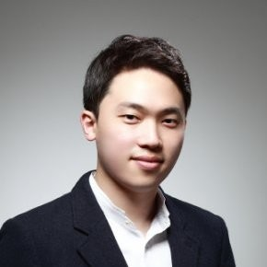
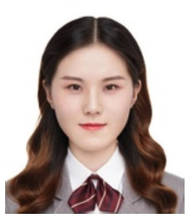
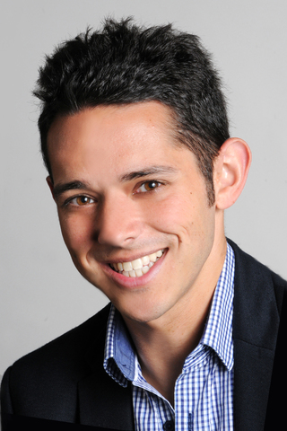
Class Format
Live Lecture Dates:
China Time: 7, 8, 9, 10 (Tu – Fri), 14, 15, 16, 17 (Tu – Fri); 08:30 – 10:05
Berkeley Time: 6, 7, 8, 9 (M– Th), 13, 14, 15, 16 (M – Th); 17:30 – 19:05
Remote Teaching: Zoom (detailed login info coming soon)
Course Website: https://scott-moura.github.io/rl/
Discussions: WeChat & Slack
Professor Scott MOURA smoura@berkeley.edu Office Hours: 30min after class
Co-instructor: Saehong Park sspark@berkeley.edu Office Hours: 30min after class
Teaching Assistant: Xinyi Zhao zxyyx48@163.com

Slide 8
About me
Professor Scott Moura
Postdoc – UC San Diego
PhD MechE – University of Michigan
MS MechE – University of Michigan
BS MechE – UC Berkeley
Selected Honors
Carol D. Soc Distinguished Grad Student Mentoring Award
NSF CAREER Awardee
Hugo O. Schuck Best Paper Award
Best Student Paper, as advisor (ACC, IFAC, DSCC)
UC President’s Postdoctoral Fellow
NSF Graduate Research Fellow

Slide 9

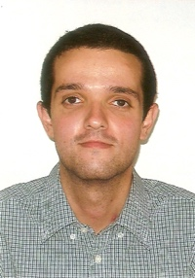
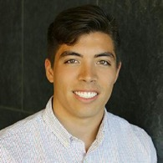
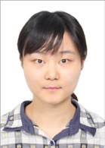

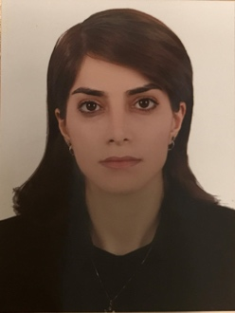
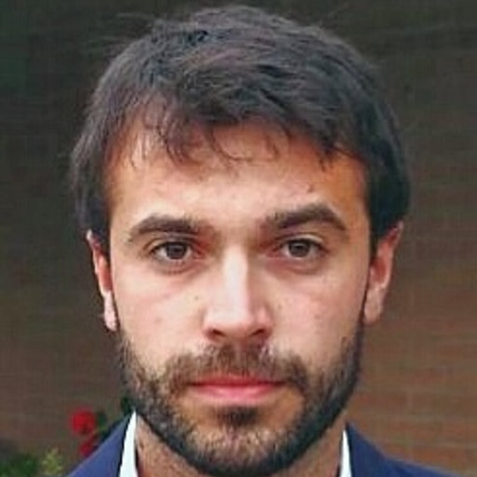
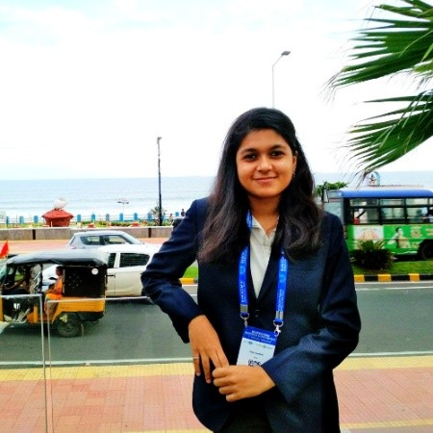

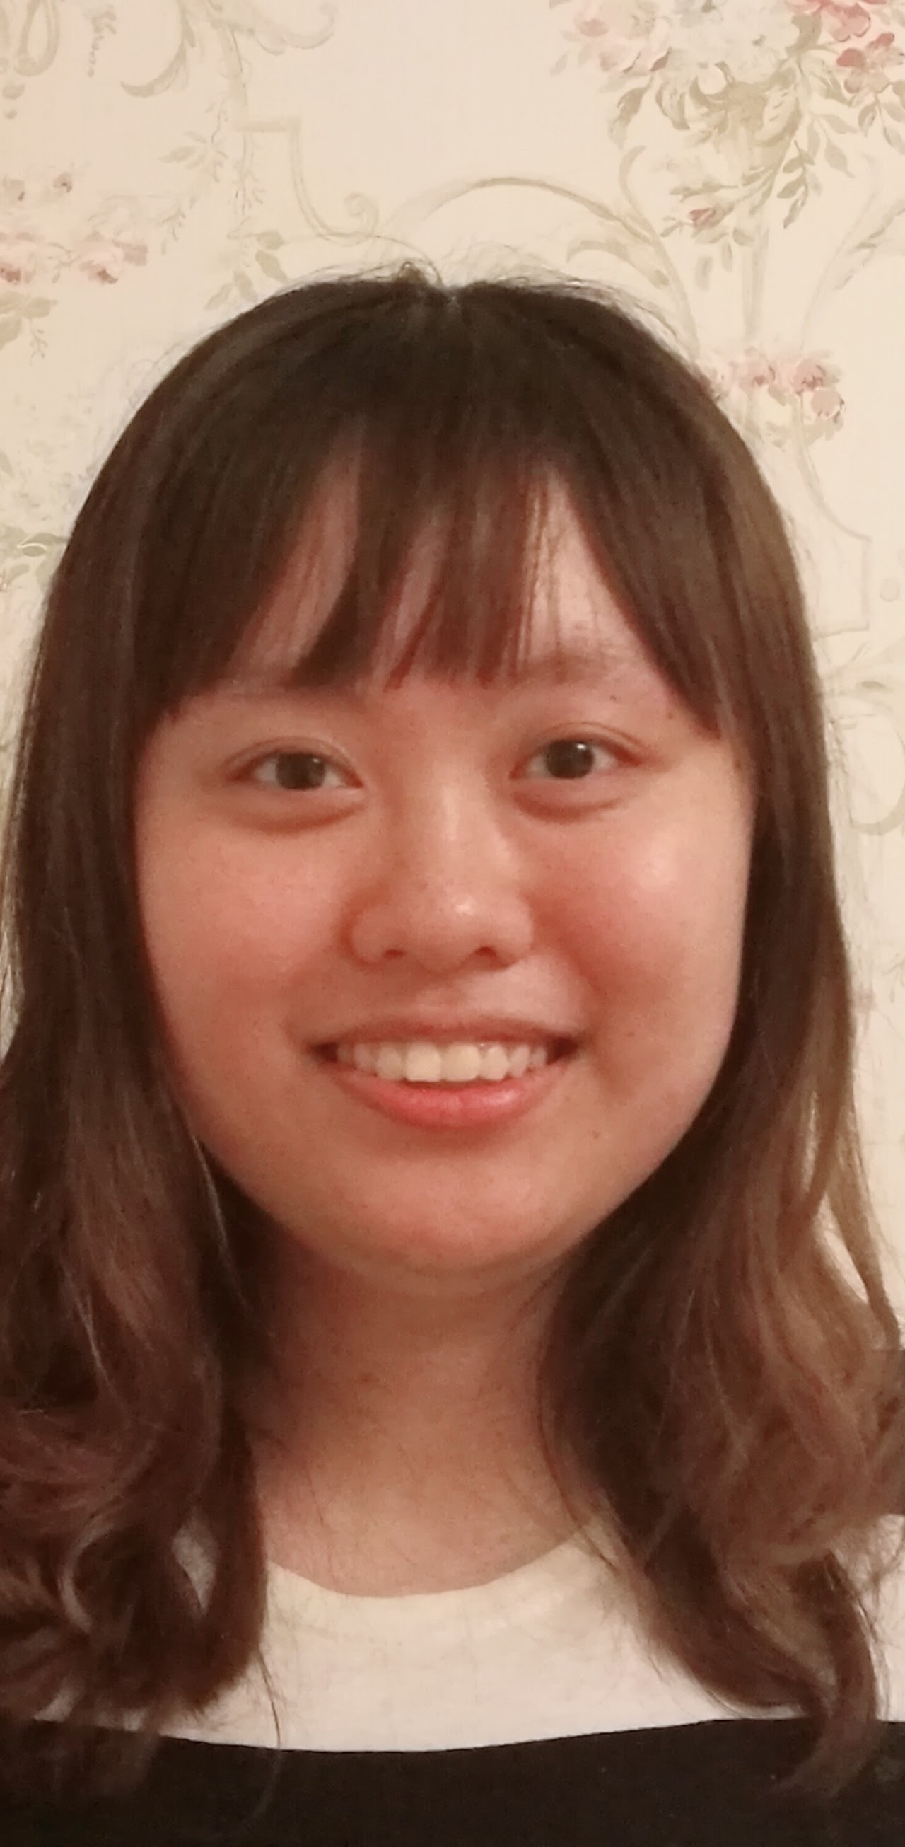

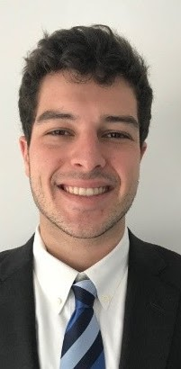
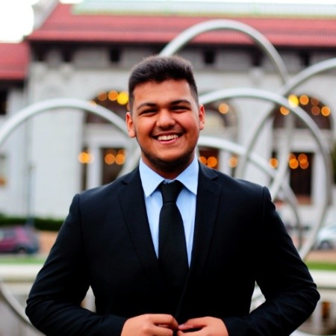
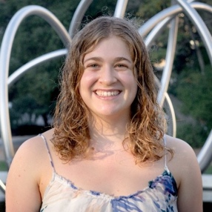
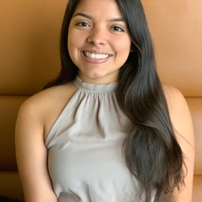
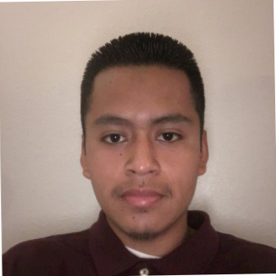
Dr. Luis COUTO (ULB/Oxford)
Laurel
DUNN
Zach
GIMA
Saehong
PARK
Dong
ZHANG
Zhe ZHOU
Sangjae
BAE
Bertrand
TRAVACCA
Mathilde BADOUAL
Soomin WOO
Yiqi
ZHAO
Ioanna
KAVVADA
Aaron
KANDEL
Jing YU (TBSI)
Shirin YOUSEFIZADEH
(Aalborg, DK)
Patrick KEYANTUO
Dylan
KATO
Teng ZENG
Yan
XIAO
Jonathan
KESTELMAN
Andrea POZZI (Pavia, IT)
Upadhi
VIJAY
Pedro ERRAZURIZ
Sihan
LIU
Deep DAYARAMANI
Sonia
MARTIN
Vanessa HERNANDEZ-CRUZ
German PEREA

Slide 10

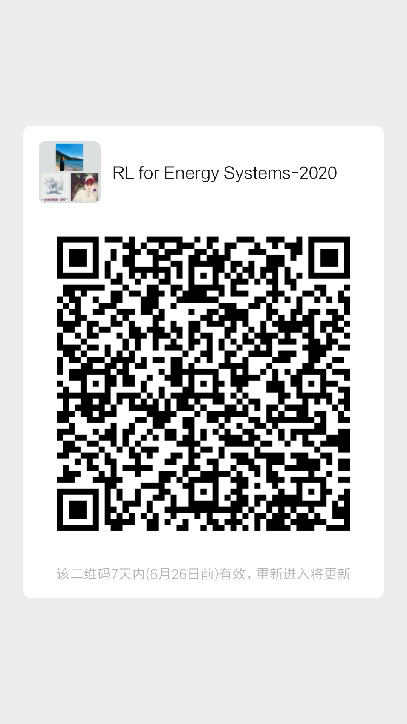

WeChat

Slide 11

Slack
Click to Join!
https://join.slack.com/t/introtorlucbtbsi/shared_invite/zt-flhuxmhu-rmGkBUOIpSxzI3d8I5F_yQ

Slide 12
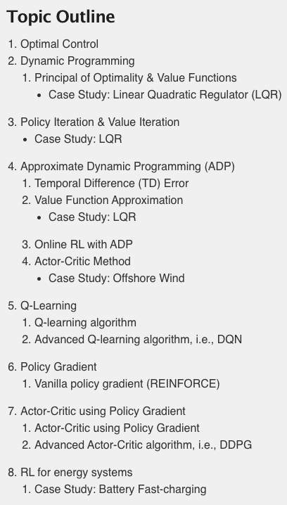
Course Organization
Lectures
Pre-recorded videos
During lecture time, watch videos, pause, discuss
Notes
Course notes available at https://scott-moura.github.io/rl/
Assignments
Two assignments
Application to Offshore Wind Energy

Slide 13
Textbooks (none are required)
The following are recommended for additional background:
D. P. Bertsekas and J. Tsitsiklis, Neuro-Dynamic Programming, Athena Scientific, 1996
﻿Powell, W. B. (2007). Approximate Dynamic Programming: Solving the curses of dimensionality (Vol. 703). John Wiley & Sons.
R. S. Sutton and A. G. Barto, Reinforcement Learning: An Introduction, 2017
﻿Lewis, F., & Vrabie, D. (2009). Reinforcement learning and adaptive dynamic programming for feedback control. IEEE Circuits and Systems Magazine, 9(3), 32–50. http://doi.org/10.1109/MCAS.2009.933854
﻿Lewis, F. L., & Vrabie, D. (2009). Reinforcement learning and adaptive dynamic programming for feedback control. IEEE Circuits and Systems Magazine, 9(3), 32–50. http://doi.org/10.1109/MCAS.2009.933854
J. Si, A. Barto, W. Powell D. Wunsch (2004). Handbook of Learning and Approximate Dynamic Programming.

Slide 14
Grading
Straight scale (we may curve up, but it has never been necessary)
Participation | 50pts | Based on attendance and interaction. Award at instructor’s discretion
Assignments | 50pts | Two assignments, 25pts each
TOTAL | 100pts

Slide 15
How to Succeed (in Remote Learning Courses)
Ask questions in class! MORE important in remote learning
LIVE discussion
See instructors during office hours
Be resourceful!
Send us a WeChat/Slack.
You are not alone!
Work together! Lift each other! Succeed Together!
You are responsible for making a better world for yourself & all

